Slide 1
Solar Proposal – A Project to Identify Promising Stock Opportunities
AI Boot Camp Project 1
Team Members:
Gale Gates
Steven Hill
Tatiana Lee
Terry Welsh

Slide 2
Project Overview
Project Purpose / Description
This project aims to develop a data-driven approach to analyzing the stock market. By leveraging historical data and identifying trends, we will create a framework to answer critical questions like which stocks are on the rise, which hold long-term potential, and how different sectors are performing.

Slide 3
Project Overview
Goals/Questions to be addressed
Which stock(s) is trending up or down?
Which stock(s) is likely to perform the best over the next 6 months based on historical data?
How are stocks performing compared to each other in this market segment?
Is there any specific seasonality that shows why this market moves?

Slide 4
Project Overview
Overview of data collection, cleanup and exploration process
Identified the type of data we would investigate - Selected top 7 Solar stocks to compare and evaluate from 01-01-2020 through 04-10-2024
Started to utilize Nasdaq data, but it ended requiring subscription. Decided to leverage Yahoo Finance to gather required data
Took steps to properly cleanse the data and align date/times to ensure full set of representative data was present for all stocks required
Performed individual review of data by mapping out closing costs and volumes to visualize consistent information
Performed process to create combined data set for overall comparison while remaining distinct datasets could be used for more specific analysis

Slide 5
Project Overview
Approach taken to achieve goals
Identify stocks for visualization (CSIQ, DQ, ENPH, FSLR, JKS, SEDG, SPWR)
Linear regression helped uncover long-term trends, guiding the data visualization process
Performed coded steps to cleanse data and ensure there was a full set of functional data to be used for analysis
Created a combined data set that would be used to visualize trends for all closing prices at once
Individually created time series plots and trends to see stock performance
Utilized prophet libraries to create predictive trends and extract seasonal trends and visualize

Slide 6
Which Stock is Trending Up or Down?
Provide a summary of the results with the supporting visualizations (at least 2 per question)
This questions aims to identify stocks that are currently experiencing significant price movements, either upwards or downwards. By understanding these trends, investors can potentially capitalize on short-term opportunities.
Notes:
Hi everyone,
I'm here to answer our first question, which stock is trending up or down? today we'll explore one company that's been riding a wave of success and another facing some challenges.

Slide 7
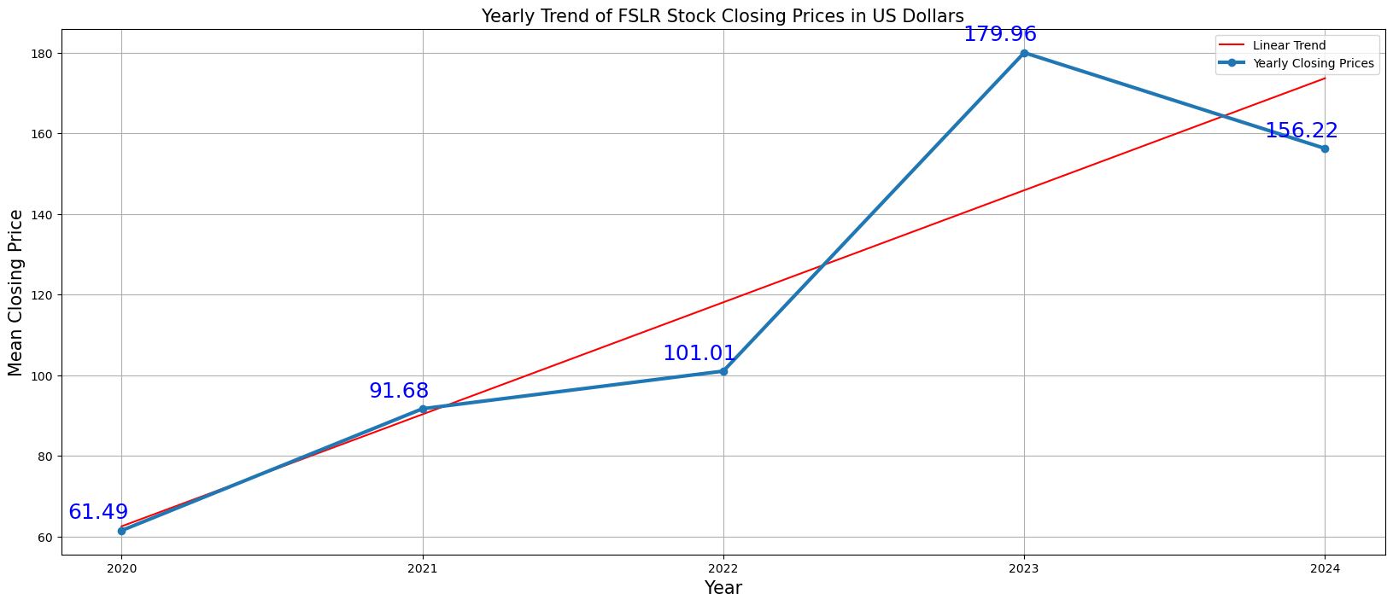
First Solar, Inc. (FSLR)
Notes:
First Solar - FSLR has been on an upward trend over the past five years.
Exceeding expectations in 2023
Boost investor confidence.
Their Ohio expansion helped them overcome supply chain challenges and lower costs.
—--------------------------------- The linear trend line shows a general upward trend in the stock prices from 2020 to 2024, indicating overall growth during this period despite the slight drop in 2022. This suggest that the stock has generally been gaining value over the long term. First Solar has been gaining popularity due to the its expanding production base is in Ohio. It is based in Tempe, Arizona and it beats rising shipments, improving average selling price with lower overhead costs, and easing supply chain issues. (Forbes, 2024)
Summary of the stock based on mean averages:
2020 - The stock started at a mean closing price of $61.49
2021 - There was a steady increase, with the stock reaching to a mean closing price of $91.68
2022 - The price continued to grow, at a $101.01
2023 - The stock significantly raised to $179.96, due Earning Estimate Revisions, First Solar was expected to post earnings indicating a change of +445% from the year-ago quarter. (Yahoo Financials)
2024 - There was a slight decline, with the stock falling to $156.22.

Slide 8
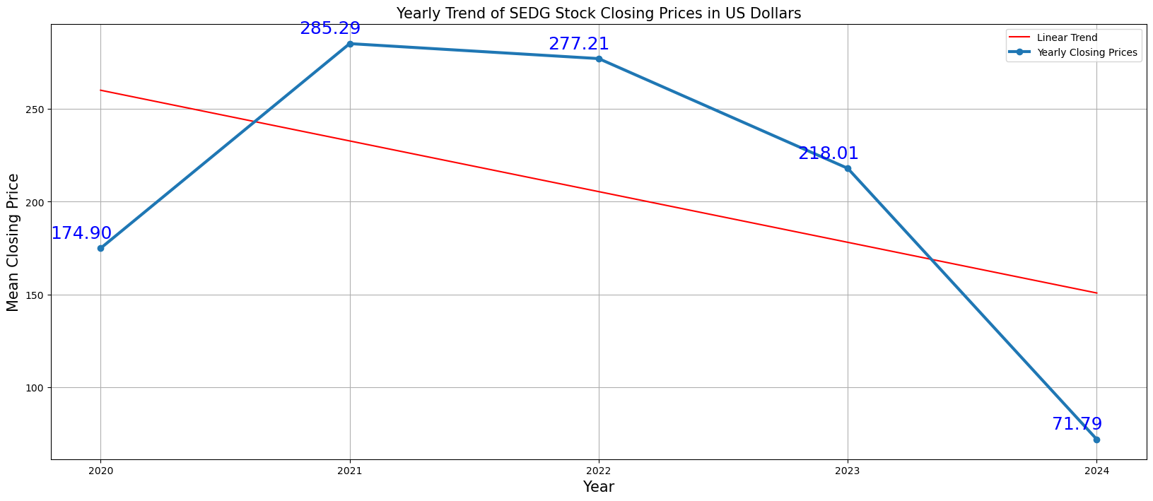
SolarEdge Technologies, Inc. (SEDG)
Notes:
Solar Edge - SEDG stock Started with a positive outlook,
Slumped after a disappointing earnings report in 2024.
Company missed revenue expectations.
Higher interest rates made it hard for business.
—--------------------------------------------------------------------
The linear trend line shows a general upward trend from 2020 to 2021, followed by a sharp downward trend from 2021 to 2024. This suggest that the stock saw significant growth initially but has been declining sharply in the latter part of the period.
Summary of the stock based on mean averages:
2020 - The stock started at a mean closing price of $174.90
2021 - There was a significant increase, with the stock reaching peak of $285.29
2022 - The price slightly declined to $277.21
2023 - The downward trend continued, lowering price to $218.01
2024 - A more substantial decrease is observed, with the stock pricing falling to $71.79

Slide 9
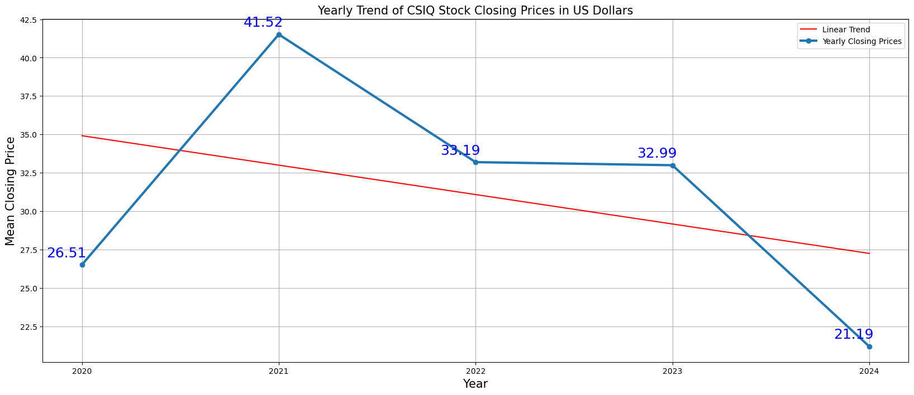
Canadian Solar Industry Inc. (CISQ)
Notes:
The linear trend line shows a general downward trend in the stock prices from 2021 to 2024, despite the initial rise in 2021. This suggests that over the long term, the stock has been losing value during this period. Summary of the stock based on mean averages:
2020 - The stock started at a mean closing price of $26.51.
2021 - There was a significant increase, with the stock reaching a peak mean closing price of $41.52.
2022 - The price experienced a decline, dropping to $33.19.
2023 - The downward trend continued slightly, with a mean closing price of $32.99.
2024 - A more substantial decrease is observed, with the stock price falling to $21.19.

Slide 10
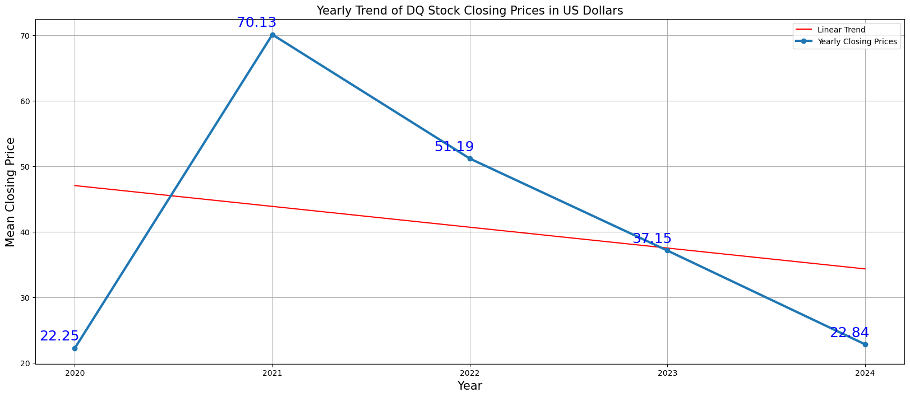
Daqo New Energy Corp. (DQ)
Notes:
The linear trend shows a general downward trend in the stock prices from 2021 to 2024, despite the initial sharp rise in 2021. This suggest that over the long term, the stock has been losing value during this period.
Summary of the stock based on mean averages:
2020 - The stock started at a mean closing price of $22.25
2021 - There was a significant increase, with the stock reaching a peak mean closing price of $70.13
2022 - The price experienced a sharp decline, dropping to $51.19.
2023 - The downward trend continued, with a mean closing price of $37.15.
2024 - A more substantial decrease is observed, with the stock price falling to $22.84

Slide 11
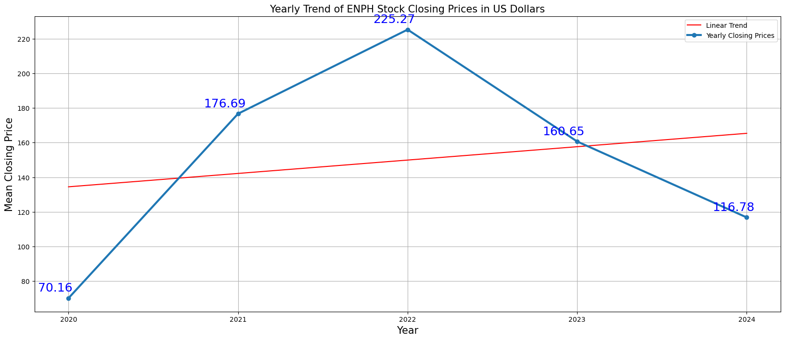
Enphase Energy, Inc. (ENPH)
Notes:
The linear trend shows a general upward trend from 2020 to 2022, followed by a downward trend from 2022 to 2024. The stock gained significant growth in the first half of the period but has been declining in the latter half.
Summary of the stock based on mean averages:
2020 - The stock started at a mean closing price of $70.16
2021 - There was a significant increase, with the stock reaching a peak mean closing price of $176.69
2022 - The price peaked even higher at around $225.27. (pre - inflation shock high)
2023 - The price then experienced a decline, dropping to around $160.65.
2024 - A further decrease is observed, with the stock price falling to $116.78.

Slide 12
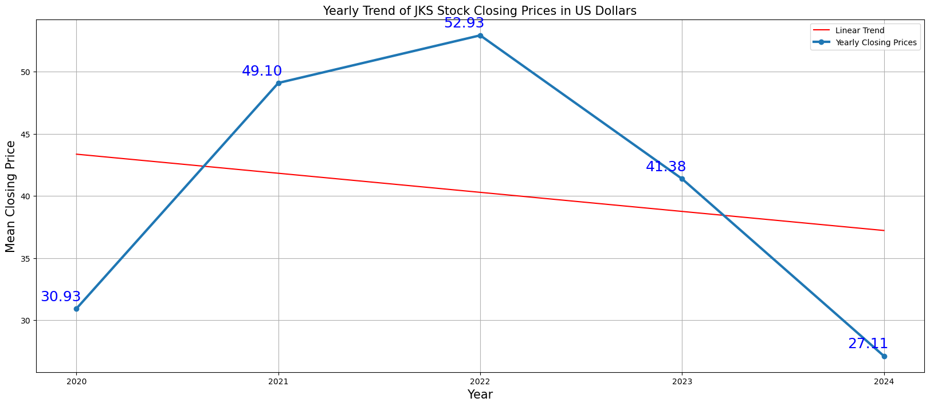
JinkoSolar Holding Co., Ltd. (JKS)
Notes:
The linear trend line shows a general upward trend from 2020 to 2022, followed by a downward trend from 2022 to 2024. This suggests that the stock saw significant growth in the first half of the period but has been declining in the latter half.
Summary of the stock based on mean averages:
2020 - The stock started at a mean closing price of $30.93
2021 - There was a significant increase, with the stock reaching a closing price of $49.10
2022 - The price peaked at $52.93
2023 - The stock then experienced a decline, droppint to $41.38
2024 - A further decrease is observed, with the price failing to $27.71

Slide 13
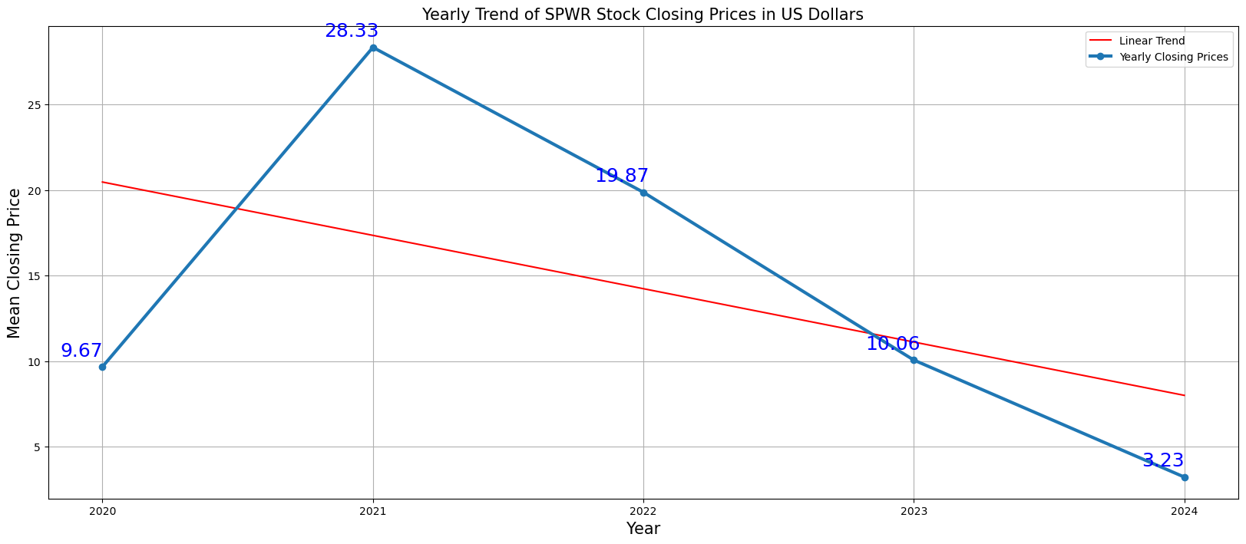
SunPower Corporation (SPWR)
Notes:
The linear trend line shows a general upward trend from 2020 to 2021, followed by a sharp downward trend from 2021 to 2024. This suggest that the stock has significant growth initially but has been declining sharply in the latter part of the period.
Summary of the stock based on mean averages:
2020 - The stock started at a mean closing price of $9.67
2021 - There was a significant increase to $28.33
2022 - The price then experience a decline to $19.87
2023 - The downward price continued, with a closing near $10.06
2024 - A further decreased is observed, with the stock price falling to $3.23

Slide 14
Which Stock is Trending Up or Down?
Summary: The analysis of the stock trends from 2020 to 2024 provides insights into the performance of each company over the specified period. CSIQ demonstrated an initial increase in 2021 but experienced a continuous decline in subsequent years. DQ, ENPH, and FSLR showed promising growth initially, but their performance faltered in the later years, resulting in a mixed trajectory. JKS experienced growth until 2022, followed by a downturn, while SEDG saw significant growth in 2021 but faced a sharp decline afterward. SPWR exhibited substantial growth until 2021, but its performance declined sharply thereafter. Overall, the trends suggest varying degrees of success and challenges for each company.

Slide 15
What stock is likely to perform the best over the next 6 months based on historical data?
Provide a summary of the results with the supporting visualizations (at least 2 per question)
This question delves into predicting future stock performance using historical data analysis. By leveraging past trends and market patterns, the project seeks to recommend stocks with promising potential for the next 6 months.
Forecasts to follow:

Slide 16
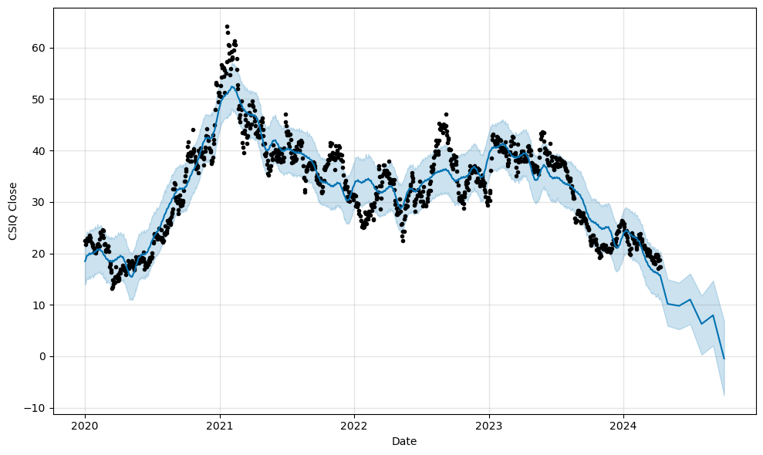
CSIQ Prediction
Notes:
CSIQ exhibits a downward trend, fluctuations suggest that seasonality influences. Model is less confident in the forecast, as represented by the wider shaded area. Distances between historical dots and blue line illustrate volatility in the stock.

Slide 17
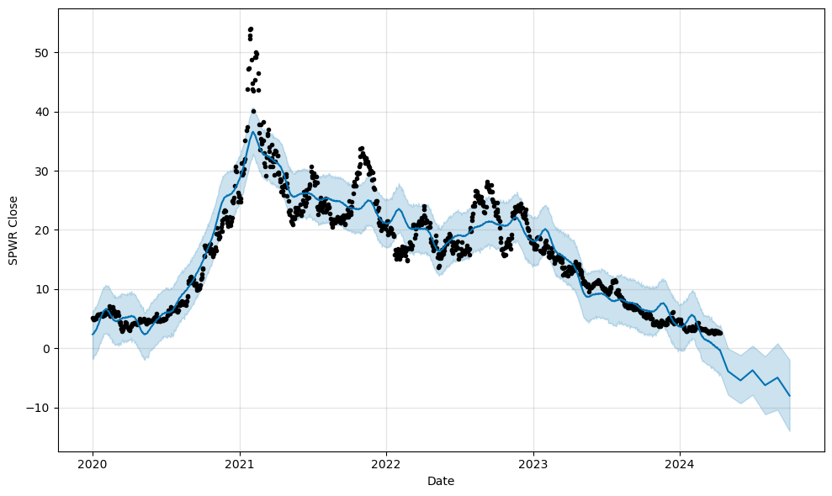
SPWR Prediction
Notes:
Forecast indicates decline within next six months. Cyclical pattern in historical dots suggest seasonality. Confidence interval becomes wider as we head into the future. Historical data shows significant volatility. Does show steepness in decline in stocks like ENPH & SEDG

Slide 18
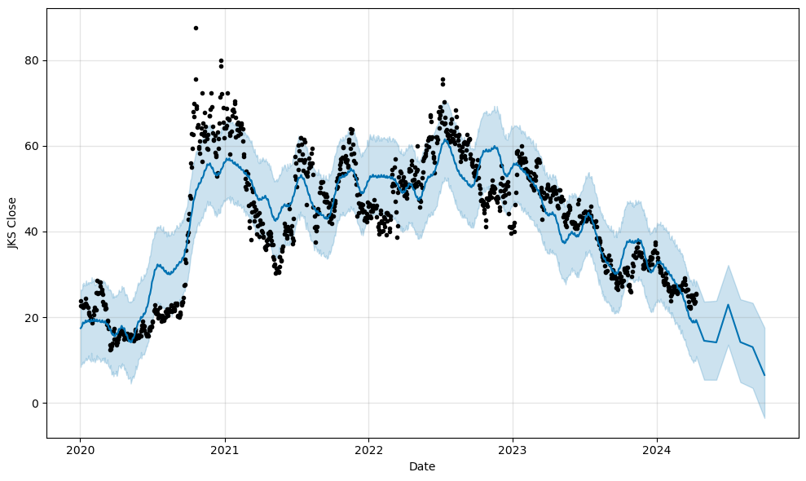
JKS Prediction
Notes:
Downward trend over next six months predicted. Pattern of ups and downs indicate seasonality. Widening confidence interval towards end shows growing uncertainty. Historical volatility. Steepness of decline not as steep as ENPH or FSLR.

Slide 19
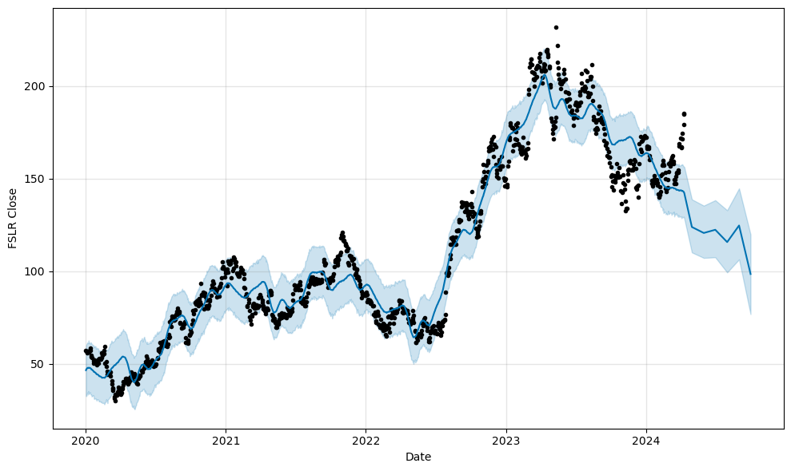
FSLR Prediction
Notes:
Trend shows closing price expected to fall over next six months. Seasonality and historical volatility depicted. Model becomes less confident as prediction moves into the future. Decline is not as sharp as ENPH after experiencing a substantial rise.

Slide 20
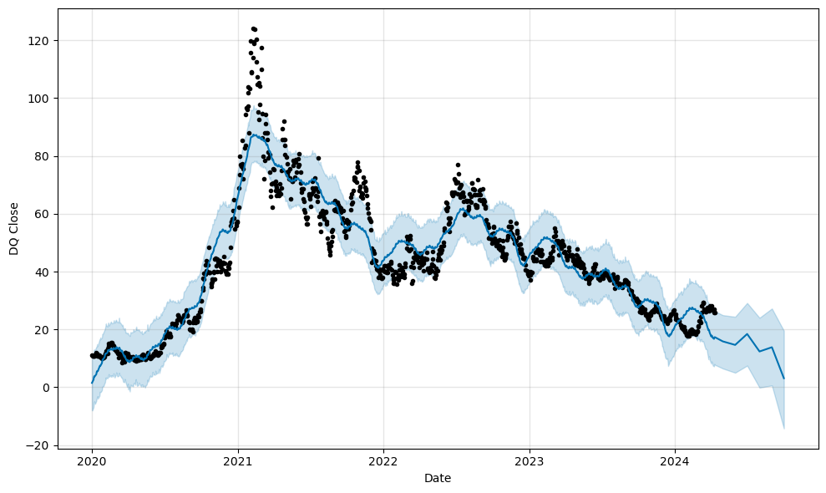
DQ Prediction
Notes:
Downward trend in price predicted in next six months. Rise and fall of historical points show potential seasonality. Confidence interval widens, just like other models. Volatility illustrated by historical points’ deviation from trend line.

Slide 21
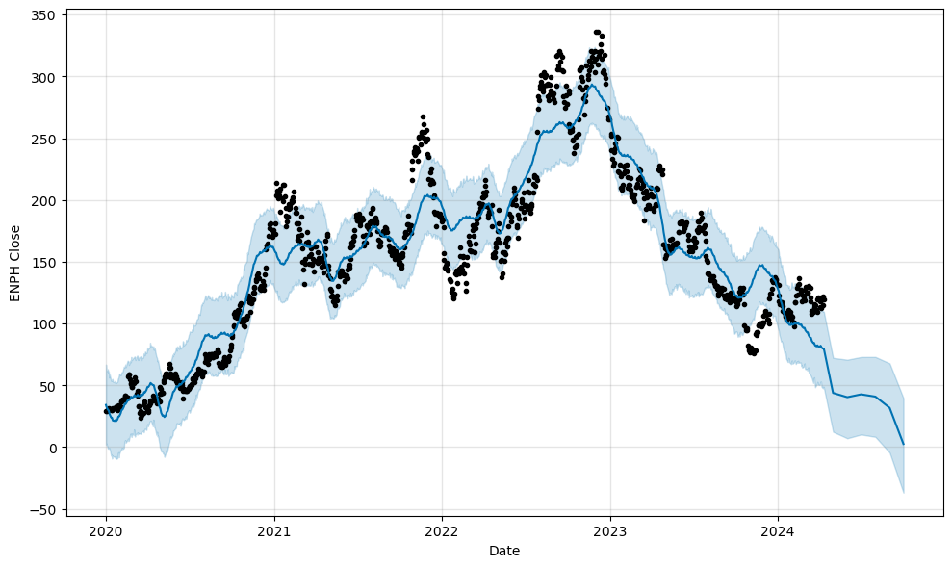
ENPH Prediction
Notes:
Model predicts decline in price over next six months. Cyclical pattern suggests seasonality impact. Like with other predictions, uncertainty increases as we move into future. Sharp rises and falls in price suggest volatility.

Slide 22
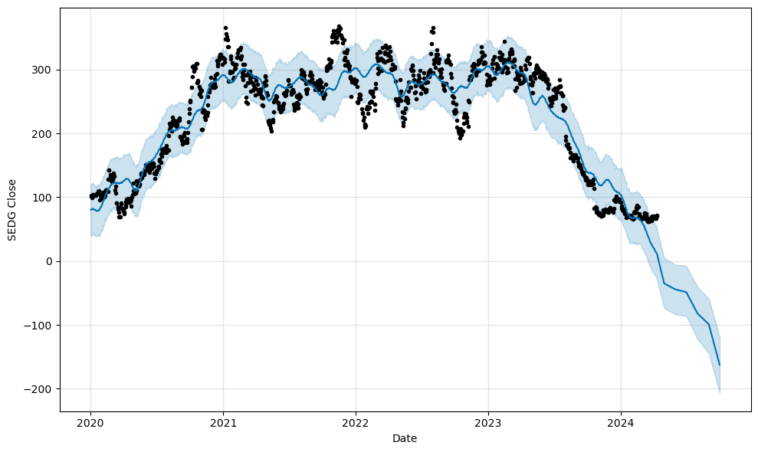
SEDG Prediction
Notes:
Downward trend in stock prices over next six months. Cyclical patterns in historical data suggest seasonality. Increased uncertainty in confidence interval of model as it goes into the future. Volatility depicted. Steepness in decline similar to ENPH & FSLR.

Slide 23
What stock is likely to perform the best over the next 6 months based on historical data?
Summary:
Based on the forecasts, none of the stocks indicate a strong likelihood of performance gains within the next six months according to the Prophet model predictions. It is important to note that each stock’s actual future performance can be influenced by many factors that are not included in the model, such as company performance, economic conditions, and global events.

Slide 24
How are stocks performing compared to each other in this market segment?
Provide a summary of the results with the supporting visualizations (at least 2 per question)
This question focuses on relative stock performance within a specific market segment. Analyzing this data can help investors identify outperformers and underperformers, enabling them to make informed investment decision.

Slide 25
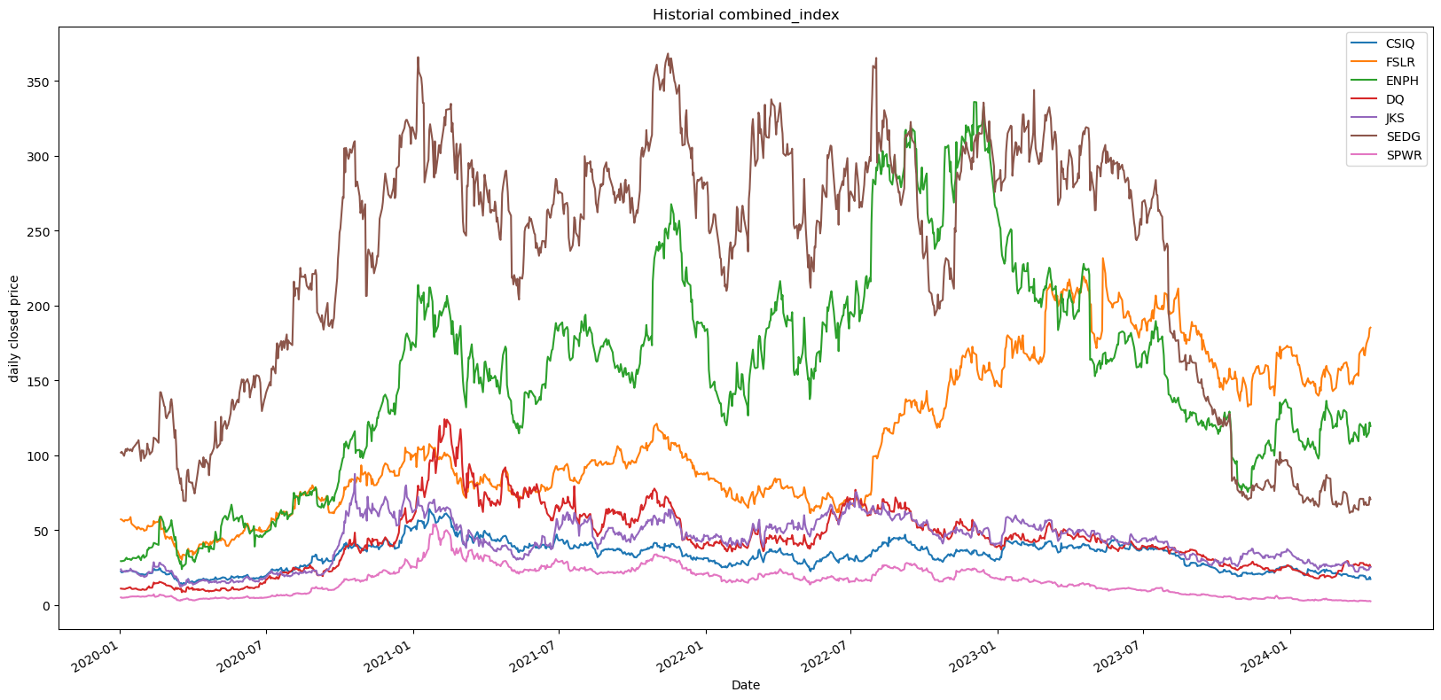
CSIQ, FSLR, ENPH, DQ, JKS, SEDG, SPWR
(7- SOLAR ENERGY COMPARISONS)
Notes:
#1 (7-Solar Energy Comparisons):
SEDG-(SolarEdgeTechnologies, Inc.) - stayed steady and reached the MAX value at $350.
ENPH-(Enphase Energy, Inc.) trending behind; however, not significantly at $322.
FSLR-(First Solar, Inc.) was trending in third place with steady dips with reaching a MAX value at $240.
DQ-(Daqo New Energy Corp.) max value was $125.
JKS(JinkoSolar Holding Co., Ltd.) max value was $85.
CSIQ(Canadian Solar Inc.) max value was $65.
SPWR(SunPower Corporation) max value was $55.

Slide 26
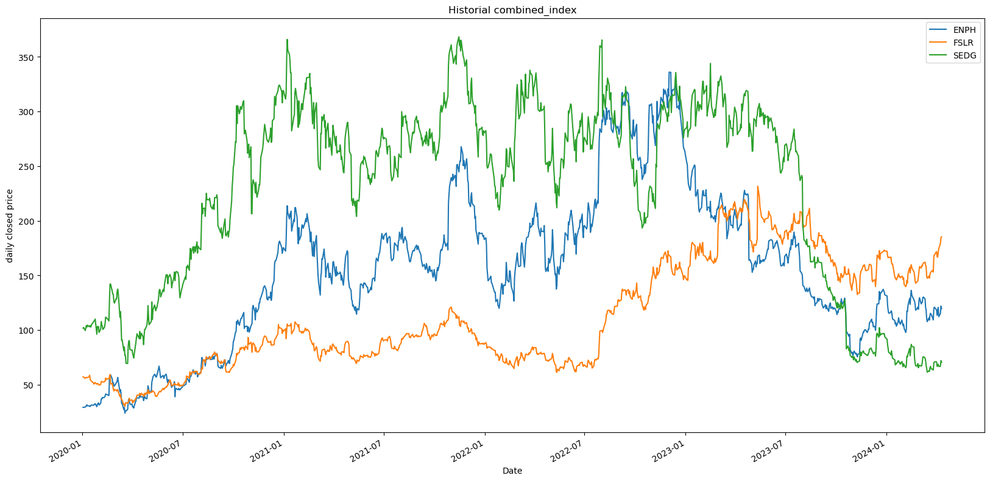
ENPH, FSLR, SEDG - Best Performers
Notes:
#2 (Best Performers):
SEDG, ENPH, and FLSR
SEDG-(SolarEdgeTechnologies, Inc.) - stayed steady and reached the MAX value at $350.
ENPH-(Enphase Energy, Inc.) trending behind; however, not significantly at $322.
FSLR-(First Solar, Inc.) was trending in third place with steady dips with reaching a MAX value at $240.

Slide 27
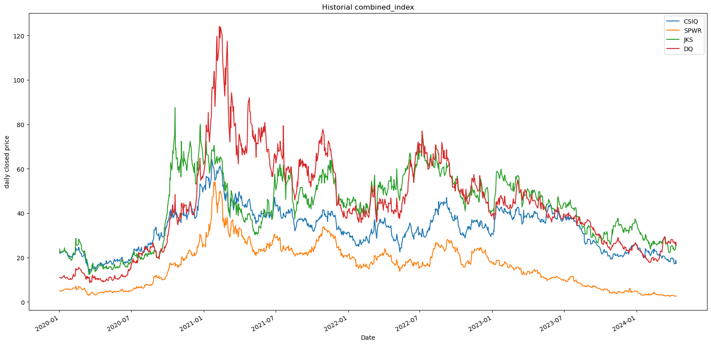
CSIQ, SPWR, JKS, DQ - Lowest Performers
Notes:
#3 (Lowest Performers):
•CSIQ, SPWR, JKS, and DQ.
DQ-(Daqo New Energy Corp.) max value was $125.
JKS(JinkoSolar Holding Co., Ltd.) max value was $85.
CSIQ(Canadian Solar Inc.) max value was $65.
SPWR(SunPower Corporation) max value was $55.

Slide 28
How are stocks performing compared to each other in this market segment?
Summary:
Stocks are compared by metrics across investors can gain a comprehensive understanding of how each company is fairing relative to its peers in the solar energy market segment. Additionally, conducting fundamental analysis and considering industry trends and competitive dynamics can further inform investment decisions and by understanding the strengths and weaknesses of each company, to provide insights into their competitive positioning within the solar energy industry.

Slide 29
Is there any specific seasonality that shows why this market moves?
Provide a summary of the results with the supporting visualizations (at least 2 per question)
This question explores the presence of seasonal trends that influence market movements. By understanding these seasonal patterns, investors can potentially adjust their strategies to align with cyclical market fluctuations.

Slide 30
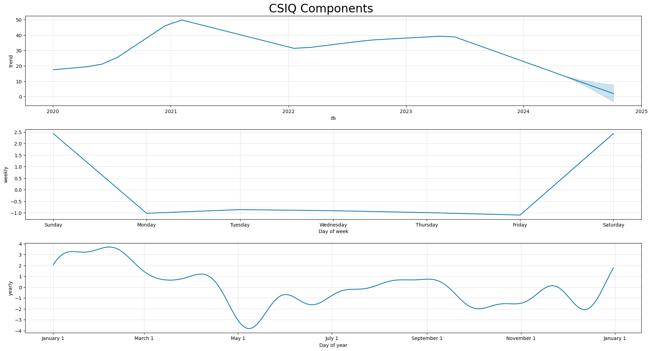
CSIQ Seasonality

Slide 31
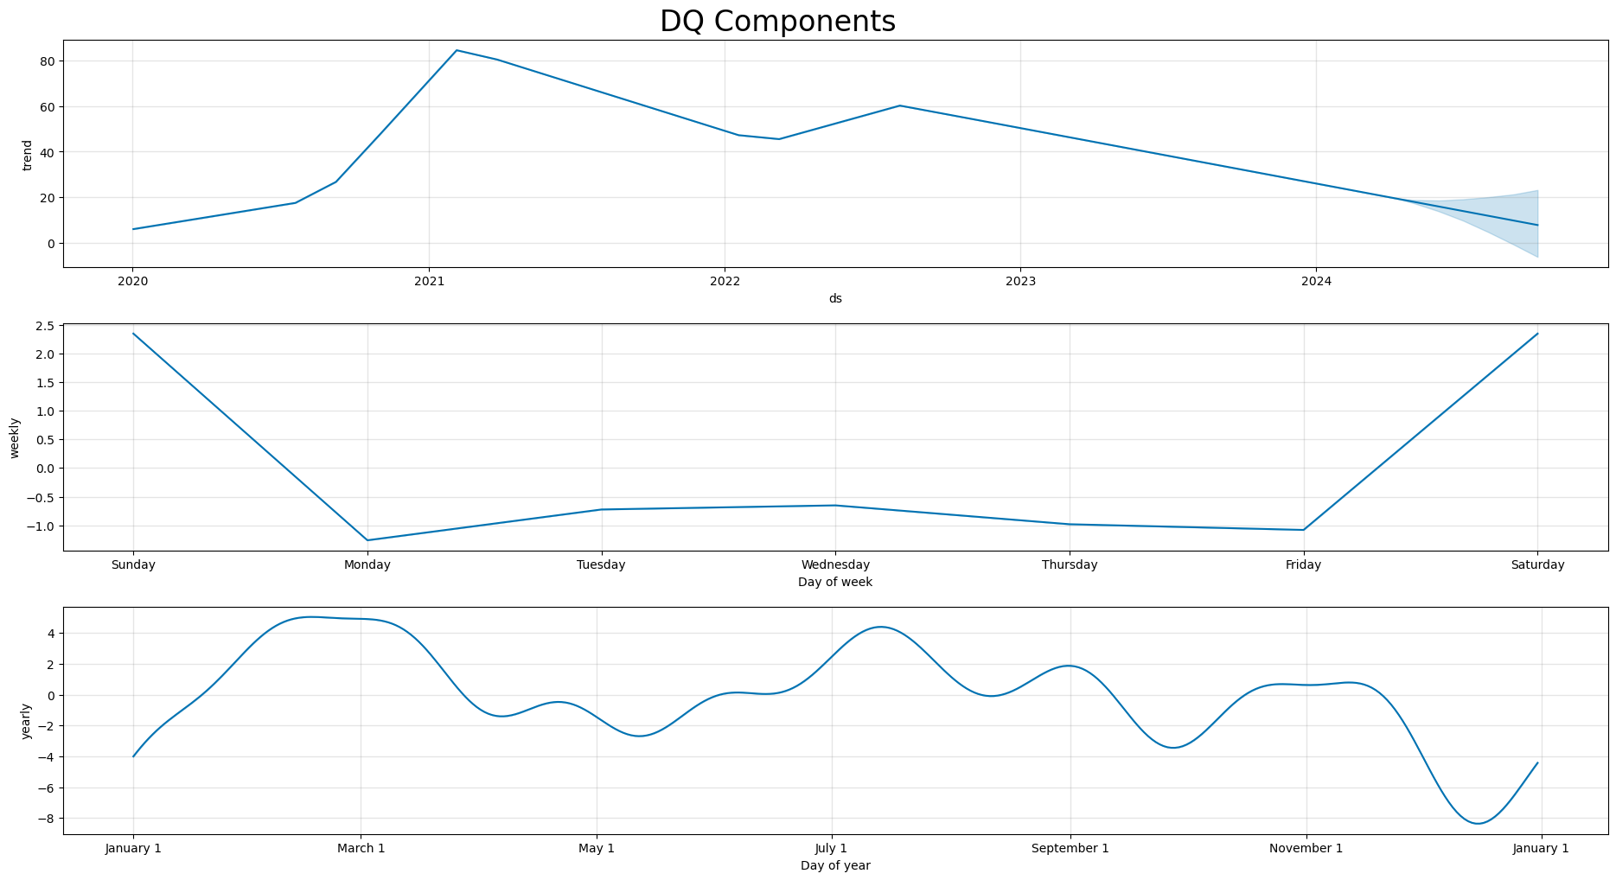
DQ Seasonality

Slide 32
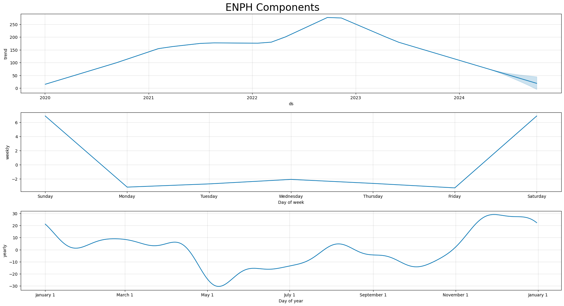
ENPH Seasonality

Slide 33
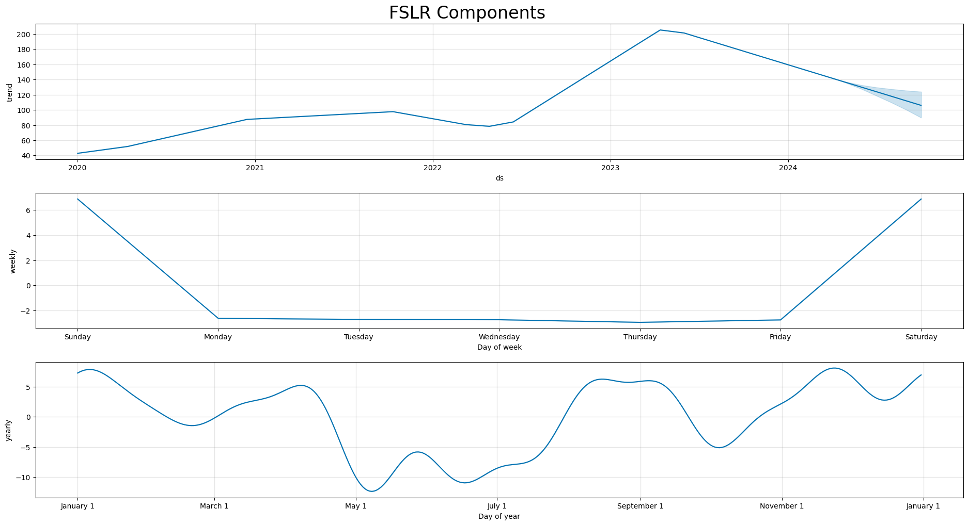
FSLR Seasonality

Slide 34
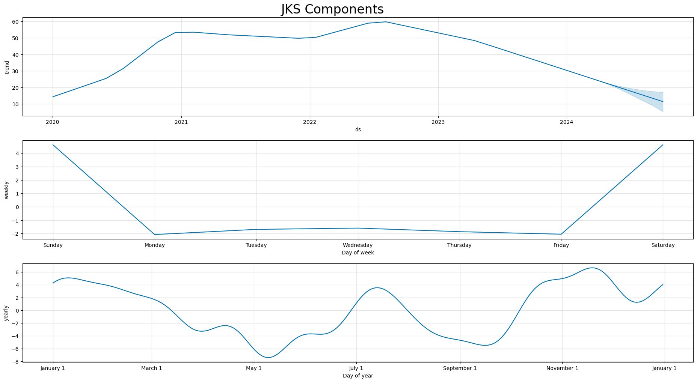
JKS Seasonality

Slide 35
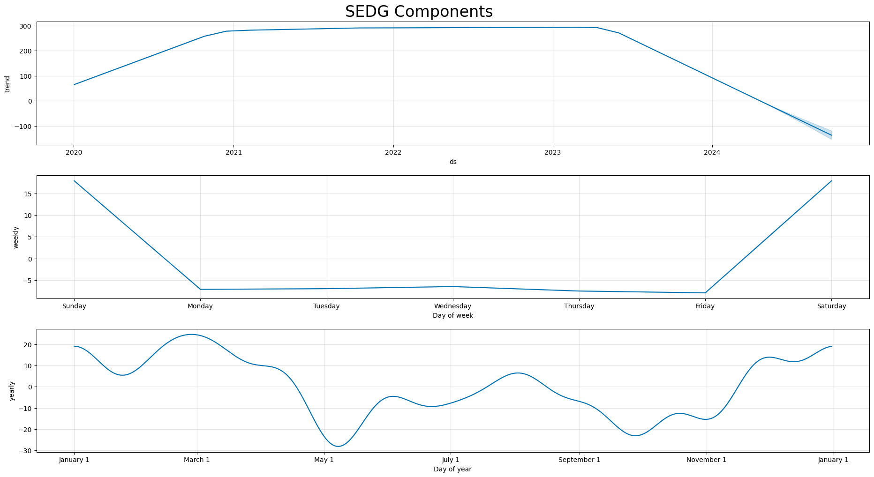
SEDG Seasonality

Slide 36
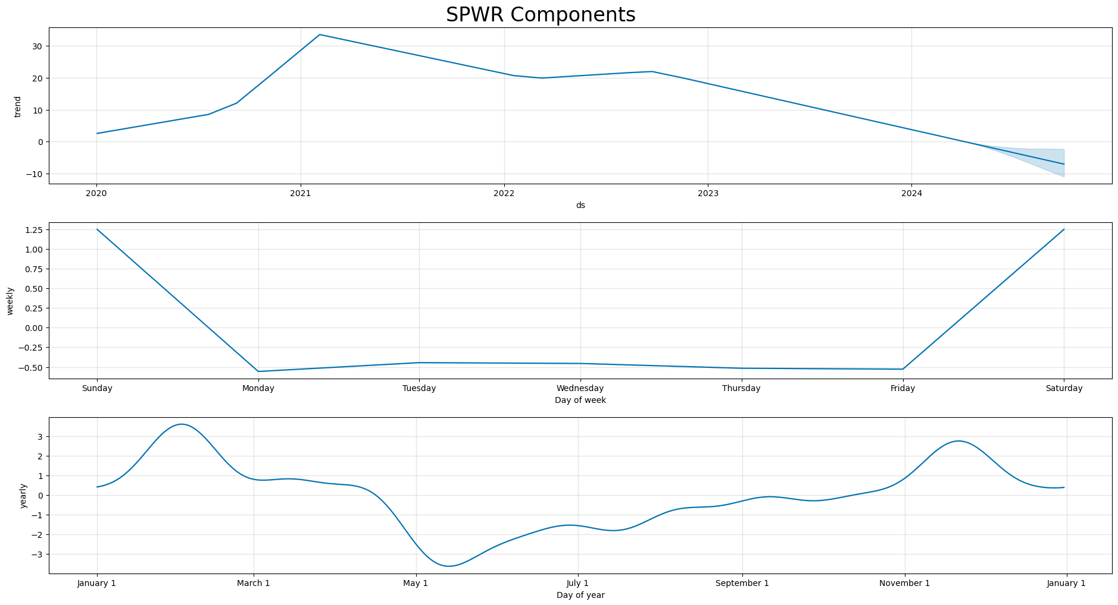
SPWR Seasonality

Slide 37
Is there any specific seasonality that shows why this market moves?
Summary:
Upon completion for each of the seasonality visuals utilizing prophet plot_components function we were able to take a close look at the collective results. Within this Solar market there was not a consistent seasonality identified across all 7 stocks. There is a clear pattern within weekly visual that reflects daily change and weekend stall(during times of no trading). The yearly trends for almost all stocks do show a similarity around the month of May which is correlated with the change in close prices for all companies. The reality for this market segment is there are too many factors that can influence each company stock individually that were not tracked as part of this data analysis.

Slide 38
What would we tell our client about investing into these solar stocks?
All of them are trending down and are forecasted to do so in the next six months. It is important to know that these predictive models do not account for unforeseen events, policy changes, economic factors, or even technological advancements that can occur. If our client wants to invest while these stocks are down, it's important to note that historical patterns demonstrated by these models do not guarantee future results.
Buying into a stock during a dip can be a strategy depending on clients’ risk tolerance. Another options could be to diversify a portfolio that can withstand market fluctuations in addition to investing into some of these stocks presented here.
Stocks like ENPH and SEDG which both have seen higher historical price points, might indicate a potential for a more substantial recovery if conditions that helped their last highs were to reemerge. Both however, showed larger fluctuations in both historical data and predicted values, which suggests higher volatility when compared to the other stocks.
DQ seemed to have a less steep decline in its model prediction, which may be indicative of a more stable outlook when compared to the other stocks’ declines.
Summary

Slide 39
Started to get data from Nasdaq but hit a roadblock with subscription service required to properly collect data needed.
Data integrity was part of the progress, team had to be extra conscientious about what data file was in use for which set of code being executed.
Problems Encountered

Slide 40

Summarize any additional questions that surfaced, what your group might research next if more time was available, or share a plan for future development.
Further data analysis could include performing additional data correlation to produce insights related to volume and closing price. The team could create more visuals that would help represent the related data elements and influences that are outside of the information we researched already. Our team could incorporate more specific recommendations inclusive of profit and loss metrics to help give a more concise direction for investors.
Future Considerations

